Slide 1

NetSecure ML – Intelligent Intrusion Detection
System
24207001 – Ashokkumar Bhati
24207010 – Aayush Balip
24207014 – Sameer Saiyed
24207020 – Keval Shah
Project Guide
Ms./Mr. Rajshree Chaudhari
Notes:
‹#›

Slide 2
Outline
Introduction
Literature Survey of the existing systems
Limitations of the existing systems
Problem statement
System Design
Technologies and methodologies
Implementation
Conclusion
References
Notes:
‹#›

Slide 3
Introduction
NetSecure ML is an intelligent Network Intrusion Detection System (NIDS) designed to safeguard digital infrastructure from unauthorized access.
The system analyzes complex network traffic patterns to distinguish between legitimate user actions and potential cyber threats.
By utilizing supervised machine learning algorithms, The system learns from historical data to predict future anomalies.
The project evaluates performance across multiple benchmark datasets, including NSL-KDD and UNSW-NB15, to ensure high reliability in diverse network environments.
The primary goal is to provide a scalable, automated security layer that enhances the resilience of modern computer networks.
Notes:
‹#›

Slide 4
Motivation
The increasing frequency and sophistication of network-based attacks necessitate smarter, more adaptive security solutions.
Conventional signature-based systems often fail to detect novel "Zero-Day" attacks that do not match known patterns.
Manual network monitoring is no longer feasible for large-scale data traffic, driving the need for automated ML-driven response systems.
The project aims to move from a reactive "patch-after-breach" mindset to a proactive system that identifies threats at the point of entry.
Leveraging vast amounts of network metadata allows for the creation of models that evolve alongside emerging cyber threats.

Slide 5
Objectives
1.Detect malicious network activities using machine learning.
2.Classify network traffic as normal or intrusion.
3.Automate intrusion detection to reduce manual monitoring.
4.Improve network security by identifying attacks at an early stage.
5.Real time security using Wireshark.

Slide 6
Literature Survey of the existing system
Sr. No. | Paper Title / Author | Dataset Used | Year | Methodology | Key Outcome
1 | ML Based IDS / Solanki et al. | NSL-KDD | 2022 | Random Forest & XGBoost | 99.2% Accuracy on DoS attacks.
2 | Deep Learning NIDS / Haider et al. | KDD Cup 99 | 2023 | MLP Neural Networks | High detection of complex patterns.
3 | Performance Analysis / Azad et al. | NSL-KDD | 2024 | SVM vs. Decision Trees | DT proved most efficient for speed.
4 | Feature Selection / Verma et al. | NSL-KDD | 2023 | Recursive Feature Elim. | 40% reduction in processing time.
5 | Hybrid RF & KNN / Zhang et al. | NSL-KDD | 2022 | Hybrid Ensemble Model | Reduced False Alarm Rate to <2.5%.
Notes:
‹#›

Slide 7
Limitations of existing systems
Survey Analysis: Current systems (manual, OCR, ERP) have major drawbacks.
Problem Status: Still far from being a fully automated and flexible solution.
Observations: Need improvements in automation, accuracy, and structured export.
Better Technologies: Python (Regex, PyMuPDF) works well for structured PDFs.
Confidence: Project can address key issues and provide an efficient automated solution.
Notes:
‹#›

Slide 8
Problem statement
Manual Monitoring Dependency: Traditional Intrusion Detection Systems (IDS) rely heavily on manual oversight, leading to delayed response times and increased human error.
Evolving Cyber Threats: Existing rule-based security frameworks struggle to identify sophisticated, evolving "Zero-Day" attacks that do not match predefined signatures.
Data Scalability Challenges: Modern network environments generate massive volumes of high-velocity data, making manual analysis and traditional filtering methods inefficient and unscalable.
Real-Time Classification Need: There is a critical requirement for an automated, machine learning-based approach to accurately classify network traffic as 'Normal' or 'Intrusion' in real-time.

Slide 9
System Design
Data Acquisition: Input includes historical benchmark datasets (NSL-KDD, UNSW-NB15) and live packets captured via Wireshark.
Preprocessing Module: Utilizes Python for data cleaning, handling missing values, and performing Label Encoding on categorical features.
Feature Engineering: Employs correlation heatmaps and regex-based parsing to identify and map the most significant network attributes.
Core Engine: Implements Different algorithms to perform entropy-based splits for high-accuracy traffic classification.
Output Layer: Generates structured performance reports including Confusion Matrices, Accuracy graphs, and real-time alerts.
Notes:
‹#›

Slide 10
Technologies and methodologies
1. Core Technologies (Tech Stack)
Programming Language: Python 3.x
Network Sniffing: Scapy (Used for real-time packet capture and network traffic analysis).
Data Processing: Pandas & NumPy (Used for data cleaning, feature scaling, and handling the NSL-KDD dataset).
Machine Learning: Scikit-learn (Used for implementing, training, and testing the classification models).
Development Environment: Jupyter Notebook / VS Code.
2. Methodology (The Approach)
Algorithm: Random Forest Classifier
An ensemble learning method that uses multiple decision trees to provide higher accuracy and prevent overfitting.
Traffic Classification: * The system analyzes packet headers extracted via Scapy.
Features are passed through the trained Random Forest model.
Detection Strategy: Supervised Learning (Binary Classification: Normal vs. Malicious).
Performance Evaluation: Measured using Accuracy, Precision, Recall, and Confusion Matrix.
Notes:
‹#›

Slide 11
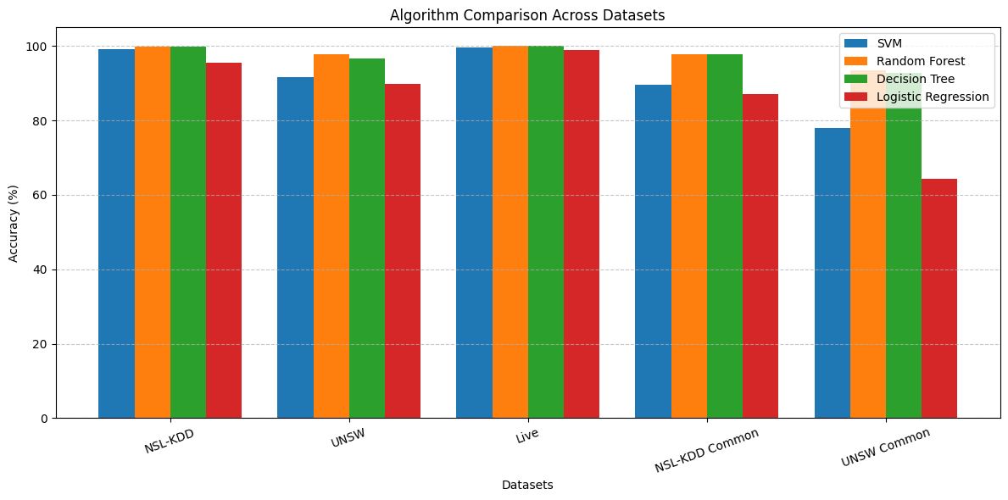
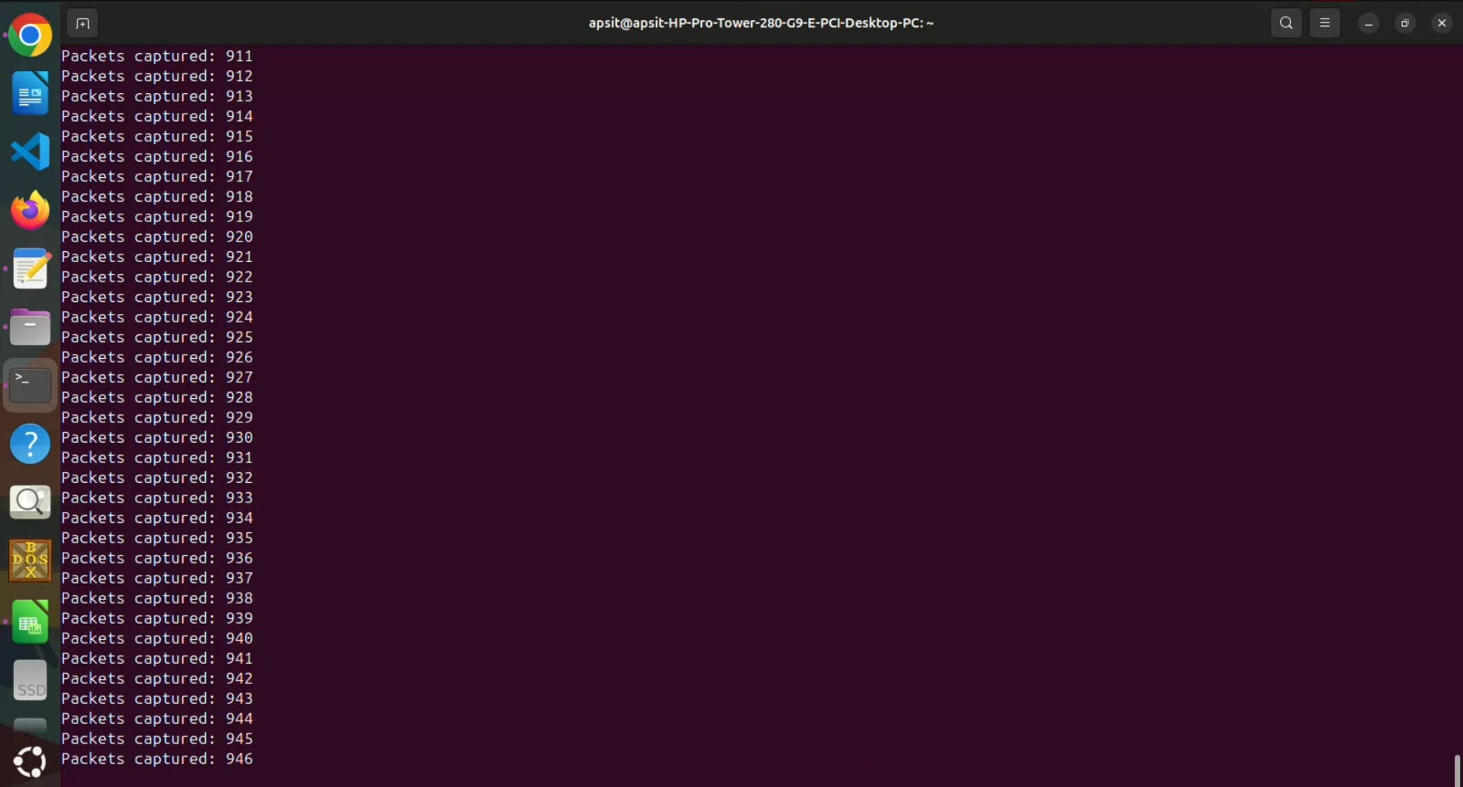
Implementation
Notes:
‹#›

Slide 12
Conclusion
The NetSecure ML system successfully demonstrates high precision in identifying intrusions compared to traditional methods.
By automating the detection pipeline, the project significantly reduces the workload on network administrators.
The model shows robust performance and adaptability when tested against both NSL-KDD and UNSW-NB15 datasets.
The modular design allows for the integration of more complex models like Random Forests or SVMs for even higher security standards.
NetSecure ML provides a scalable, intelligent, and proactive solution to modern cybersecurity challenges.
Notes:
‹#›

Slide 13
References
Jamie Lemon, Text Extraction Strategies with PyMuPDF, Artifex Software Blog, Vol. n/a, 2025. https://artifex.com/blog/text-extraction-strategies-with-pymupdf
PyMuPDF Documentation, Official Guide to PyMuPDF (fitz) Library, Artifex Software, 2025: https://pymupdf.readthedocs.io/en/latest/
Martin Thoma, The Python PDF Ecosystem in 2024, Medium, Vol. n/a, 2024. https://martinthoma.medium.com/the-python-pdf-ecosystem-in-2024-2cad87732e49
PyMuPDF Documentation, PyMuPDF — Tutorial & API, 2025. https://pymupdf.readthedocs.io/en/latest/tutorial.html
Django Software Foundation, Django Documentation: URL Dispatcher, djangoproject.com, 2025. https://docs.djangoproject.com/en/5.2/
Meta Open Source, React Official Documentation, React.dev, 2025. Link
Notes:
‹#›

Slide 14
Thank You...!!
Notes:
‹#›

